Slide 1
NL2SQL:
BERT-based Model For SQL Generation
Tinglong Liao Xue Bai Yuhan Yao

Slide 2
TABLE OF CONTENTS
01
02
03
04
Background
Data
Why do we choose this task?
What does the data look like?
Model
Evaluation
How do we use BERT to accomplish our task?
Current result and analysis

Slide 3
01
Background

Slide 4
Background
NL2SQL
Chinese
2
SQL
CSCI-SHU 213 Databases
Empowering non-programmers to interact with databases easily
Goal: Convert Chinese questions into corresponding SQL commands accurately

Slide 5
02
Data

Slide 6

Data: Train-Val-Test Split
Q&A
Tables
Train
41,522
5,013
10
Validation
8,482
2,299
2
Test
1
4,055
978

Slide 7
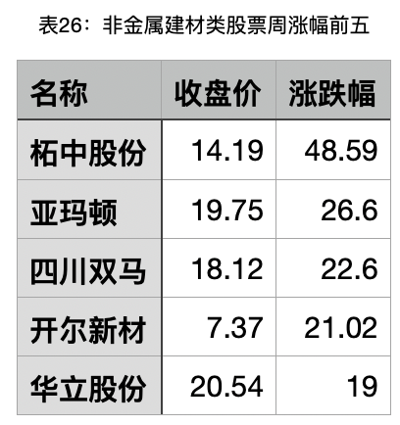
Data: Example
Natural Language
“收盘价超过15并且涨跌幅超过25的股票有哪些呢？”
SQL Language
SELECT 名称
FROM 表26：非金属建材类股票周涨幅前五
WHERE 收盘价 > 15 AND 涨跌幅 > 25

Slide 8
Data: Example
Data
agg = {0:"", 1:"AVG", 2:"MAX", 3:"MIN", 4:"COUNT", 5:"SUM"}
op = {0:">", 1:"<", 2:"==", 3:"!="}
conn = {0:"", 1:"and", 2:"or"}
"sql": {"sel": [0],
"agg": [0],
"conds": [[1, 0, 15],
[2, 0, 25]],
"cond_conn_op": 1}
SELECT 名称
FROM 表26：非金属建材类股票周涨幅前五
WHERE 收盘价 > 15 AND 涨跌幅 > 25

Slide 9
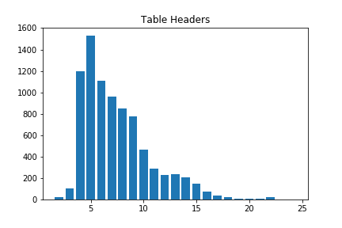
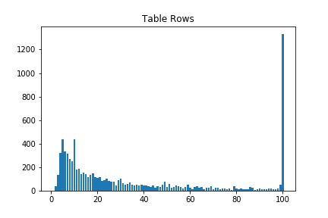
Data: Table Characteristics

Slide 10
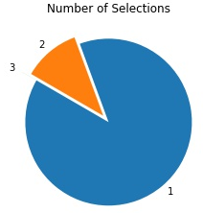
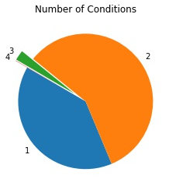
Data: Query Characteristics
SELECT 名称
FROM 表26：非金属建材类股票周涨幅前五
WHERE 收盘价 > 15
AND 涨跌幅 > 25

Slide 11
03
Model

Slide 12
We formulate this problem:
NOT as a translation problem
But as a slot-filling classification problem
2 models

Slide 13
S-num
S-col
S-col-agg
W-num
W-col
W-col-op
W-col-val
W-op
h[CLS]
h收
...
h[SEP]1
h名
h称
h[SEP]2
...
h[SEP]4
BERT - hfl/chinese-bert-wwm-ext
Token Emb
E[CLS]
E收
...
E[SEP]
E名
E称
E[SEP]
...
E[SEP]
[CLS] 收盘价超过15并且涨跌幅超过25的股票有哪些呢 [SEP] 名称 [SEP] 收盘价 [SEP] 涨跌幅 [SEP]
Type Emb
T
T
...
T
T
T
T
...
T
E0
E0
E1
E1
E1
E1
E1
Position Emb
E0
E1
...
E25
E26
E27
E28
...
E36

Slide 14
S-num
(B, 3)
h[CLS]
W-num
(B, 4)
# of selections = [0, 1, 2]
# of conditions = [0, 1, 2, 3]
conn = {0:"", 1:"and", 2:"or"}
agg = {0:"", 1:"AVG", 2:"MAX", 3:"MIN", 4:"COUNT", 5:"SUM", 6:NOT SELECTED}
op = {0:">", 1:"<", 2:"==", 3:"!=", 4:NOT SELECTED}
W-op
(B, 3)
h[SEP]1
S-col-agg
(B, 3, 7)
h[SEP]2
h[SEP]3
W-col-op
(B, 3, 5)
h[SEP]4

Slide 15
Double Tower Model: Question Encoder
Question
Encoded
Question
Question Encoder

Slide 16
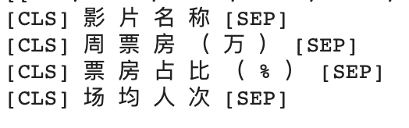
Double Tower Encoder: Table Encoder
Headers
Table Encoder
Encoded
Headers

Slide 17
Double Tower Encoder: Selecting Headers
Encoded
Header
logit
(B, H)
Encoded
Question

Slide 18
Double Tower Encoder: Classification Headers
Encoded
Header
Logit
(B, H, C)
Encoded
Question

Slide 19
Double Tower Model Structure
S_Header
SEL
Question
Encoded
Question
Question Encoder
C_Header
AGG
C_Header
CONN
Headers
Table Encoder
S_Header
COND_COL
Encoded
Headers
C_Header
COND_OPP

Slide 20
04
Evaluation

Slide 21
Evaluation Matrices
Matrices(Accuracies) | Baseline | Model1 | Model2
#SELECT | 89.94%
SELECT | 21.04%
SELECT AGG | 89.38%
#WHERE | 49.46%
WHERE | 26.14%
WHERE operation | 59.51%
WHERE Connection Operator | 48.11%

Slide 22
Takeaway & Future Work
Multi-task learning: Summing up losses
Adding Constraints: String vs Num

Slide 23
THANKS
Q&A

